Slide 1
An Open Source Friendly RPCBroker
Joel L. Ivey, Ph.D.
JIVEY@JIVEYSOFT.COM
JOELIVEY@GMAIL.COM

Slide 2
Summary of Open Source RPCBroker
If SSH is used:
checks to insure SSH is active before connecting and no encoding of access/verify codes or context option
If SSH is not used:
Each connection gets a unique encoding table, which is immediately replaced with another unique table which is encoded during transmission
ALL data is encoded, not just access/verify codes and context option
Provides ability to use two factor authentication via cell phone (SSH as well)
Provides ability to disconnect after a desired time of no interaction with server and reconnect with no loss of data or user interaction (SSH as well)
Server side code and files are in KBBP* namespace, not VA namespaces (XWB and XUS)
If the basic VA connection is used - immediately transfers processing to VA code - the client will attempt VA encoding, then if that fails OSEHRA encoding

Slide 3
The RPCBroker – Some History
The original idea was proposed by Joel Ivey at a meeting of VA developers in 1994.
Different applications were being developed using different programming languages and the head of development wanted to switch to a single language. I suggested that if we used a Broker interface on the server for our remote procedure calls then applications in multiple languages could talk to the server if they used the same protocol.
It was decided by management, however, that we would all use the same programming language, Delphi (pascal), which was just being released as a product.
I built the Remote Procedure File, Enrique Gomez and David LaLiberte (?) built the original client side RPCBroker, and Wally Fort did most of the server side work. Subsequently, Danila Manapsal, Don Creaven, and Raul Mendoza were also involved in various aspects of the work.
From about 2000 until my retirement from the VA at the end of 2012, I took over client side development of the RPCBroker. Herlan Westra has taken over development since.

Slide 4
The VA RPCBroker Functionality
The Remote Procedure Call Broker (RPCBroker) is compiled into client applications (at one point in time we also had a DLL for other languages, but that hasn't been updated in way too long).
After a connection is made, the user is asked to sign on, and the access/verify codes are encoded using a set pattern and transmitted. After sign-on is completed, the context option for the application is also encoded and transmitted. All other communication is NOT encoded.
After a period of time without any RPCs being sent, the RPCBroker sends an 'XWB IM HERE' RPC to let the server know it is still there and maintain the connection.
After many years of being told that the applications were not to do security, Wally Fort and I finally added the ability for the RPCBroker to make SSH connections, initially using the open source Plink, and then when the VA went to Attachmate for its terminal emulator which also supported SSH, we added support for Attachmate. Access/Verify and context option names are still encoded.

Slide 5
The Open Source RPCBroker
The Open Source RPCBroker provides the ability to use two factor authentication using cell phones.
If an SSH connection is used, there is no need for encoding access/verify codes or Context Option names so encoding tables are not used. None of the rest of this matters if SSH is used.
For the Open Source RPCBroker the default connection type of this Broker is with FULL encoding – ALL transmissions are encoded – not just 'access/verify codes' and context option name. With the default connection, every connection gets a new set of unique encoding patterns, and then a new encoded set. So, it is NOT dependent on a specific encoding pattern.
Instead of sending Keep Alive messages, the broker disconnects from the server – after saving all local variables and data under the ^TMP($J, and ^TMP(variable,$J, nodes. On the next RPC call as long as within a set time, the connection is restored, new encoding patterns are established and the RPC call completed – without user involvement.
When using the basic VA connection type, with the encoding patterns that have been released many times, this version of the RPCBroker tries to connect with the VA encoding and if that fails it uses the OSEHRA encoding.
Broker Development is based on that released for XWB*1.1*60.

Slide 6
Open Source RPCBroker Server Side Support
The server side support is provided by files, options, remote procedures and routines in the KBBP namespace and ^KBBP global locations.
Routines based on original XWB VA routines are in the KBBPXWB* namespace and original XUS routines are in the KBBPXU* routines. Under new headers, they still contain their original headers.
There are unit test routines under the KBBPUX* namespace.
If the basic VA connection is selected, the KBBPXWB1 routine immediately passes it to the VA code for all subsequent processing.

Slide 7
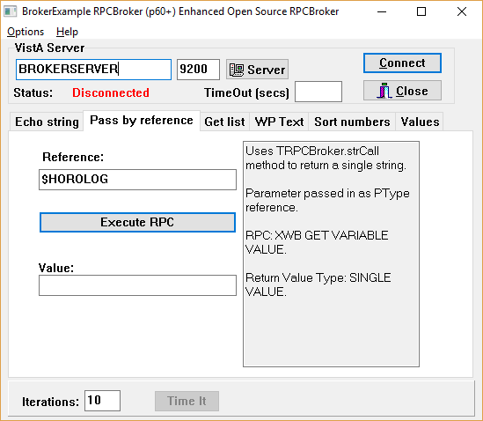
The BrokerExample60os Application
The BrokerExample application provides a
testbed for the functionality in this version of
the RPCBroker, as well as an example for developers of how the various features can be used.
It is similar to previous versions, with an added Values tab and a box to adjust timeout periods to more rapidly test the timeout functionality.
The additions at the bottom permit running the functionality of the tabs multiple times while timing the amount of time required. This can be used to compare the different connection types.

Slide 8
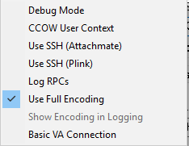
The Options Menu
The options Debug Mode and CCOW User Context have not been
changed.
The SSH connections check that the port used to connect with
the tunnel on the client can not be used to connect to the server
if SSH is down.
Use Full Encoding is the default connection type
Basic VA Connection should be selected to use the original VA connection.
'Log RPCs' can be turned on to view the data sent and received for each RPC. Applications can do this by setting the LogRPCs property of the Broker to true.
In the BrokerExample 'Show Encoding in Logging' can only be turned on if Full Encoding is selected. The latter shows both unencoded and encoded data sent and received for the RPCs. Access/Verify codes are redacted.

Slide 9
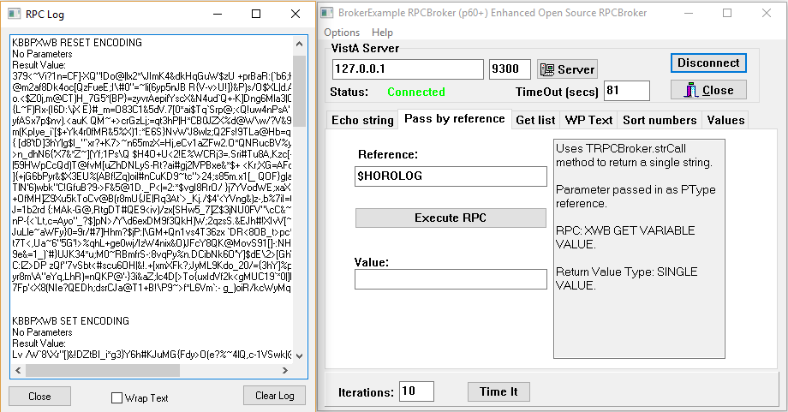
Initial RPCs Reset and then Set Encoding

Slide 10
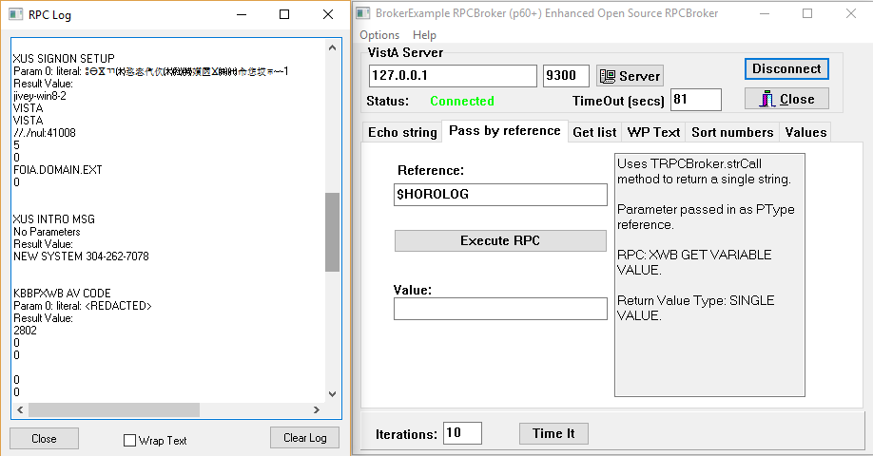
Next RPCs on Connection with only Logging On

Slide 11
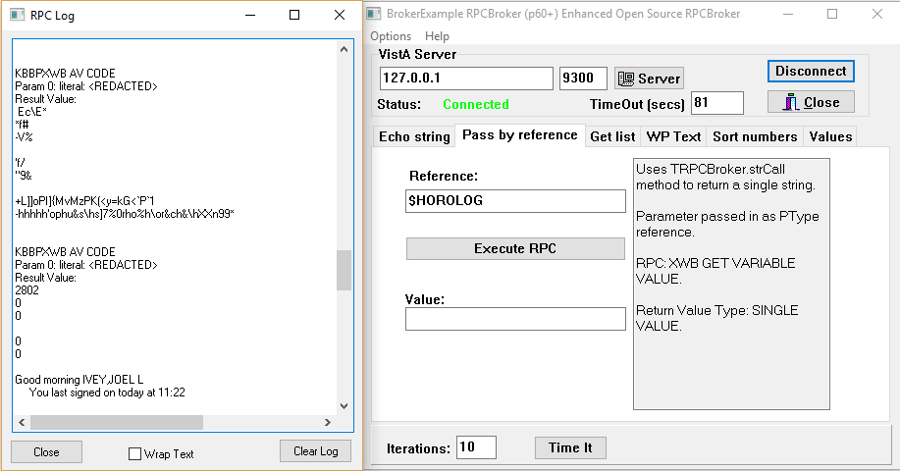
Logging for A/V Code with Encoded Logging Shown as well

Slide 12
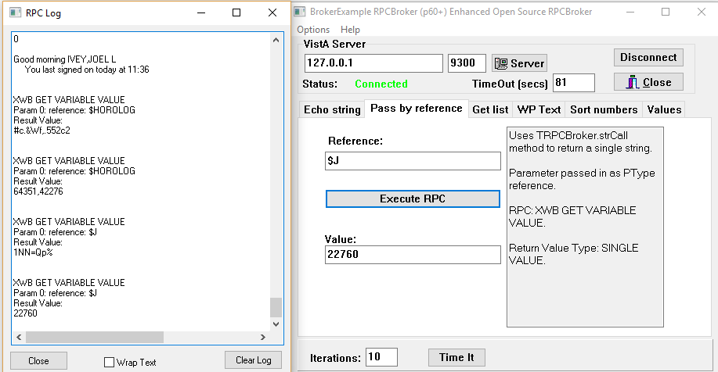
Logging with both shown for two 'XWB Get Variable Value' RPCs

Slide 13
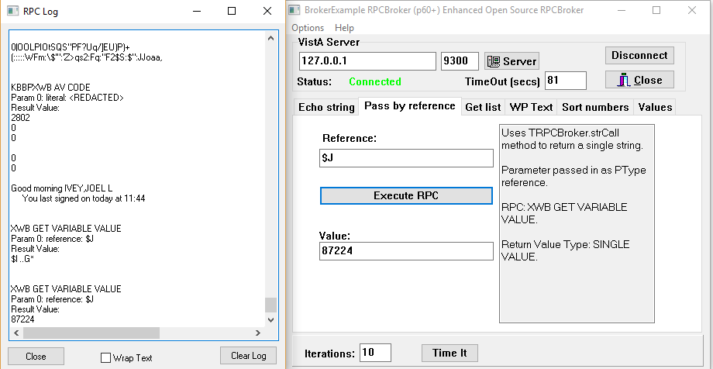
XWB Get Variable Value after timeout
Note AV Code RPC followed immediately by Get Variable Value RPC

Slide 14
The New Values Tab in BrokerExample
The Values Tab was added to demonstrate the leave and return functionality
After a specified period, the Open Source RPCBroker releases the current job, storing both local data variables and data under the ^TMP($J, and ^TMP("LABEL",$J, nodes,
After this when the user runs an RPC, the connection is restored, and the local data and global data restored under the new $J value.
The Values tab was added to be able to update data before and after the reconnection process.

Slide 15
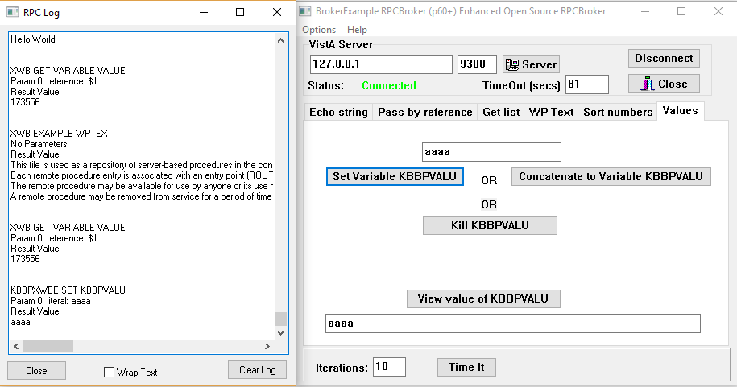
The Values Tab
In the Values Tab enter text and click 'Set Variable KBBPVALU' - this creates or updates the value. After a timeout enter text and click concatenate. The result should be the full string. Note $J is 173556

Slide 16
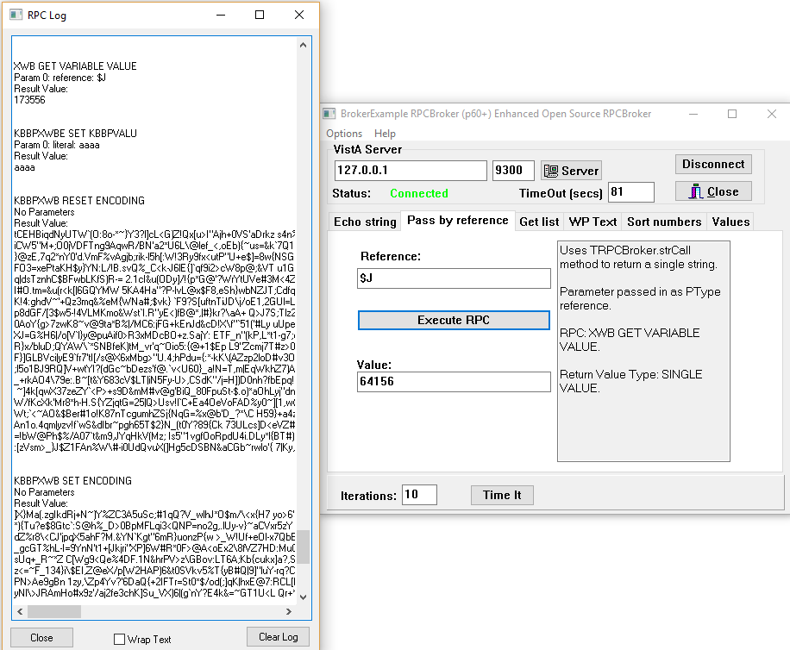
The Reconnection Process on a New RPC after timing out
The top of the log shows the Job number and initial KBBPVALU, then after waiting over two minutes (timeout in 81 seconds) on entering a string of bbbb and clicking concatenate, the log shows the reset encoding as it reconnects followed by the set encoding to get an encoding set which is encoded in transit.

Slide 17
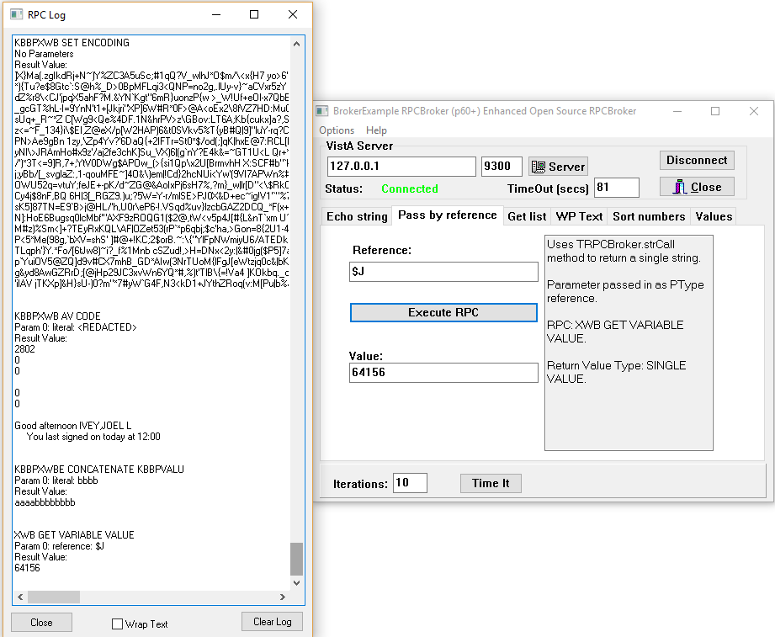
The Reconnection Process - Continued
The previous set encoding RPC is at the top, followed by the KBBPXWB AV CODE as it reauthenticates followed by the result of the Concatenate RPC (which shows both aaaa and bbbb) followed by a Get Variable Value for $J to show the new $J value.

Slide 18
Support for Cell Phone Two-Factor Authentication-1
The VA is going to two factor authentication with smart cards.
Some services, such as Google, provide two factor authentication with cell phones
The Open Source RPCBroker supports use of two factor authentication with cell phones in VistA
To activate set the USE TWO FACTOR AUTHENTICATION field (#.05) in the 'KBBP SYSTEM PARAMETERS' file (#11338991.1)
During sign-on, it becomes active when a user has an entry in the TWO FACTOR USER DATA file (#11338991.2) and a cell phone number is entered for the user (hopefully with a cell carrier)
If Two Factor authentication is active after the user authenticates with access/verify codes, identification for the computer is sent to the server (this includes computer name, user name, and computer serial number).

Slide 19
Support for Cell Phone Two-Factor Authentication - 2
If the user has a cell phone number entered,
has the user authenticated from the computer before,
if so is it a non-public system,
and if so how long has it been.
If the first answers are no or it has been too long, a 6 digit number is sent to the users cell phone and a new form presents for the user to enter the value and indicate whether it is a public computer or not.
There may be several tries before it disconnects (configurable).
NOTE – you may need to contact some carriers to have them process text messages from your mail server. The 'KBBP TEST CELL CARRIER' option can be used to test carriers.

Slide 20
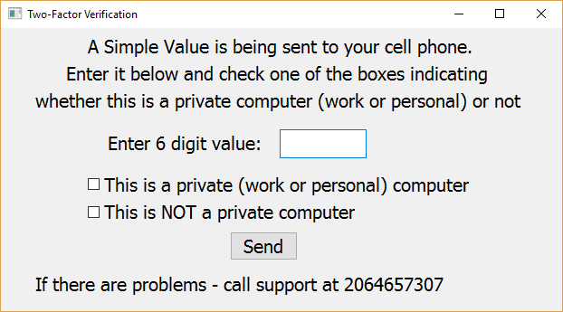
The Two-Factor Verification Window

Slide 21
The 'KBBP SYSTEM PARAMETERS' file (#11338991.1)
.01 KERNEL SYSTEM PARAMETER ENTRY – points to 8989.3
.02 ACTIVITY TIMEOUT VALUE - seconds
.03 MAXIMUM PERIOD OF INACTIVITY - minutes
.04 CASE SENSITIVE VERIFY CODE – NOT IMPLEMENTED
.05 USE TWO FACTOR AUTHENTICATION – turns on 2 Factor Authentication
.06 CELL TWO FACTOR FREQUENCY – determines how long between requests
.07 SUPPORT PHONE NUMBER – in case the user can't get it to work
.08 MAXIMUM NUMBER OF TRIES

Slide 22
The other Open Source RPCBroker-Related Files
The 'Two Factor User Data' file (#11338991.2)
.01 NAME - points to NEW PERSON file
.02 TWO FACTOR CELL #
.03 TWO FACTOR CELL CARRIER – points to #11338991.3 (below)
1 TWO FACTOR LOG (multiple)
.01 TWO FACTOR LOG - system identifying information
.02 MARKED AS PRIVATE - user indicates work or personal vs public
.03 LAST DATE AUTHENTICATED
The 'TWO FACTOR TEXT MESSAGE LINKS' file (#11338991.3)
.01 NAME - name of carrier
.02 GATEWAY ADDRESS - e-mail address for texts

Slide 23
Still to come?
Support for HTTPS/TLS connectivity is in the works as well, but not ready yet.

Slide 24
Questions?
Joel Ivey, Retired – but still playing with code
joelivey@gmail.com
jivey@jiveysoft.com

